Slide 1
Propagation Graph Neural Networks lecture-14 Course on Graph Neural Networks (Winter Term 20/21)
Christian Medeiros Adriano (christian.adriano@hpi.de) - “Chris”
Sona Ghahremani (sona.ghahremani@hpi.de )
Prof. Dr. Holger Giese (holger.giese@hpi.de)

Slide 2
Quick recap – Where are we now?
Intro and Course Organization
Graph Metrics and Random Models
Graph Structural Features – Clustering
Message Passing & Belief Propagation
Graph Embeddings - Message Passing
PageRank & Markov Chains
Graph Convolutional Networks
Graph Attention Networks
Graph Evolution Networks
Temporal Graph Networks
Graph Neural Differential Equations
Deep Graph Generative Models
Causal Graph Neural Networks
Propagation Graph Neural Networks
Network Effects, Cascading and Contagion
Outbreak Detection and Influence Maximization
Design concerns
Understand a phenomenon
Extract features
Stablish baselines
Preprocessing data
Description models
Predict an outcome
ML architecture and pipeline
Training models
Evaluation models
Prediction models
Effects of interventions
Risks of confounding
Causal structure
Intervention models

Slide 3
Topics
Network Cascades Phenomena
Decision-Based Models (Technology adoption)
Probabilistic Models (Contagion)
Outbreak detection and intervention
Minimize time to detection and
Minimize the number of affected nodes
Maximize the number of detected outbreaks
Outlook (next semester)
Machine Learning-based Feedback-Control of Dynamical Network Systems
Identifiability, Observability, Stability, Sensitivity
Methods for Highly Scalable Network Systems
Scalability, Sparsity, Reliability
Quantum Programming with Applications to Machine Learning
Notes:
Dimensionality reduction (Control Theory, Dimensionality Reduction, Latent-Variable Models)
Discrete Optimization, Randomization, Exploration/Exploitation, Immutable Architectures, Microservices

Slide 4
Information Cascade Phenomenon
Definition: Information cascade consists of a set of sequential decisions that are correlated. Originally studied in behavioral economics and network theory.
“When individuals in a social network make decisions that depend on what others have done earlier, there is the potential for a cascade to form — a run of behaviors that are highly correlate” [Chierichetti, Kleinberg, Panconesi 2003]
Information cascade versus Herd behavior [Çelen & Kariv 2004]
Informational cascade: individuals ignore their private information to make a decision
Herd behavior: individuals make an identical decision, but not necessarily ignoring their private information
1
2
3
t₁
t₂
t₃
t_{i+1} = t_{i}+Δ
Empirically identifying a cascade phenomenon from a sequence of events is not obvious. Discrete time steps is one possible rule.
Chierichetti, F., Kleinberg, J., & Panconesi, A. (2014). How to schedule a cascade in an arbitrary graph. SIAM Journal on Computing, 43(6), 1906-1920.
Notes:
[Kempel, Kleinberg & Tardos 2003] In an arbitrary network,the outcome of such a cascade can depend sensitively on the order in which nodes make their decisions, butto do date there has been very little investigation of how this dependence works, or how to choose an orderto optimize various parameters of the cascade
[Çelen & Kariv 2004] Çelen, B., & Kariv, S. (2004). Distinguishing informational cascades from herd behavior in the laboratory. American Economic Review, 94(3), 484-498.
Dobson, Ian, et al. "Complex systems analysis of series of blackouts: Cascading failure, critical points, and self-organization." Chaos: An Interdisciplinary Journal of Nonlinear Science 17.2 (2007): 026103.
Kinney, R., Crucitti, P., Albert, R., & Latora, V. (2005). Modeling cascading failures in the North American power grid. The European Physical Journal B-Condensed Matter and Complex Systems, 46(1), 101-107.

Slide 5
Example of a product adoption cascade
If p>0.5, i.e., more than half of my neighbors chose product Red, then I also choose Red
2
2
2
1
1
2
1
1
1
1
2
2
2
2
3
4
5
t₁
t₂
t₃

Slide 6
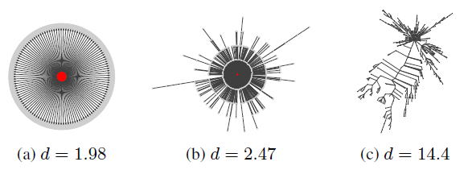
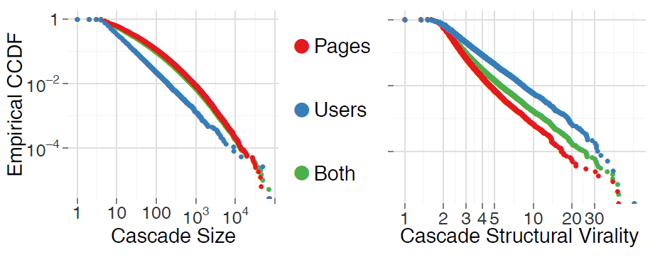
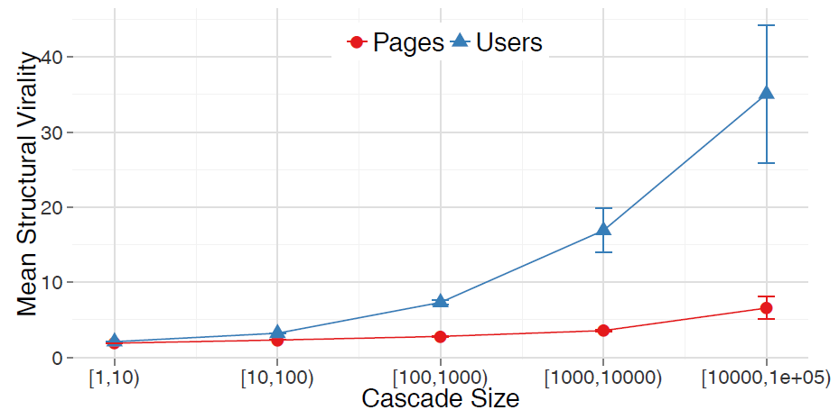
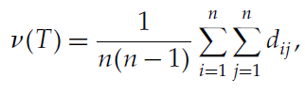
Cascade size (nodes) and virality (Wiener index)
The complementary cumulative distribution (CCDF) of cascade size (left) and structural virality measured by using the Wiener index (right).
Wiener index (or structural virality) v(T) is the average distance between all pairs of nodes in a diffusion tree T ; that is, for n>1 nodes,
[Cheng et al. 2014]
The mean structural virality (Wiener index) increases with cascade size, but it is significantly higher for user cascades.
length of the shortest path
[Goel et al. 2016]
[Cheng et al. 2014]
Cheng, J., Adamic, L., Dow, P. A., Kleinberg, J. M., & Leskovec, J. (2014). Can cascades be predicted?
Goel, S., Anderson, A., Hofman, J., & Watts, D. J. (2016). The structural virality of online diffusion.
Notes:
Cheng, J., Adamic, L., Dow, P. A., Kleinberg, J. M., & Leskovec, J. (2014, April). Can cascades be predicted?. In Proceedings of the 23rd international conference on World wide web (pp. 925-936).
Goel, S., Anderson, A., Hofman, J., & Watts, D. J. (2016). The structural virality of online diffusion. Management Science, 62(1), 180-196.
Wiener H (1947) Structural determination of paraffin boiling points.
J. Amer. Chemical Soc. 69(1):17–20.

Slide 7
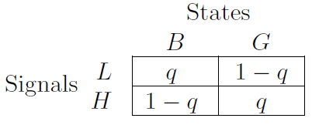
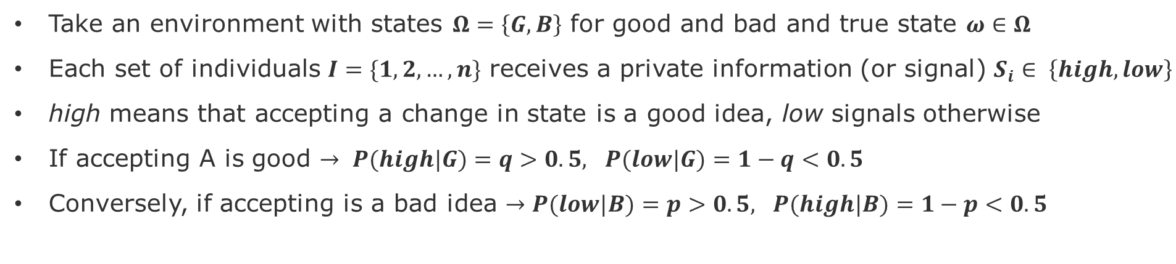
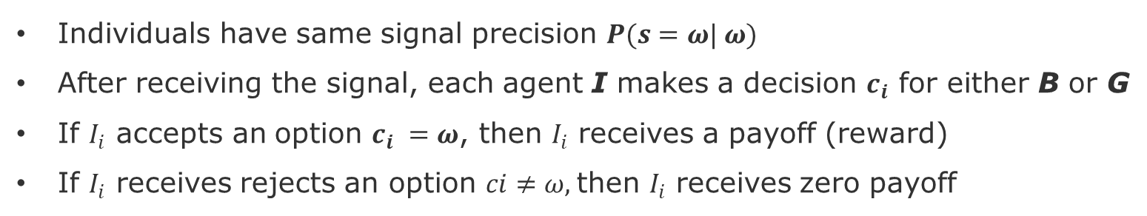
A Cascade Model – Decisions, Signal, Payoffs
Take an environment with states $Ω=\left\{G,B\right\}$ for good and bad and true state $ω∈Ω$
Each set of individuals $I=\{1,2,…,n\}$ receives a private information (or signal) $S_{i}∈ \left\{high,low\right\}$
high means that accepting a change in state is a good idea, low signals otherwise
If accepting A is good $→ P(high|G)=q>0.5, P(low|G)=1−q<0.5$
Conversely, if accepting is a bad idea $→P(low|B)=p>0.5, P(high|B)=1−p<0.5$
Probabilities of receiving a low or high signal, as a function of the two possible states of the environment (G or B).
Individuals have same signal precision $P(s=ω| ω)$
After receiving the signal, each agent I makes a decision $c_{i}$ for either B or G
If $I_{i}$ accepts an option $c_{i} =ω$, then $I_{i}$ receives a payoff (reward)
If $I_{i}$ receives rejects an option $ci≠ω,$then $I_{i}$ receives zero payoff
Alevy, J., et al., (2007), Information Cascades: Evidence from a Field Experiment with Financial Market Professionals
Easley, D.,& Kleinberg, J., (2010) Networks, Crowds, and Markets: Reasoning about a Highly Connected World.
Notes:
The expected payoff from accepting in the absence of other information is equal to 0;
Chapter 16 Information Cascades
Easley, D.,& Kleinberg, J., (2010) Networks, Crowds, and Markets: Reasoning about a Highly Connected World.

Slide 8
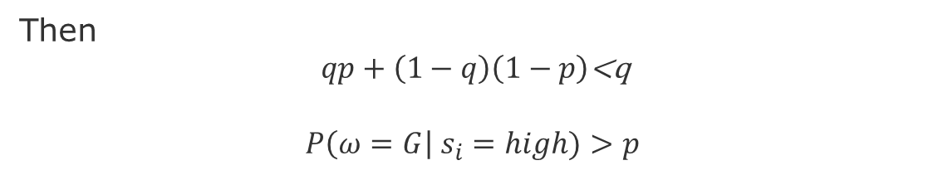
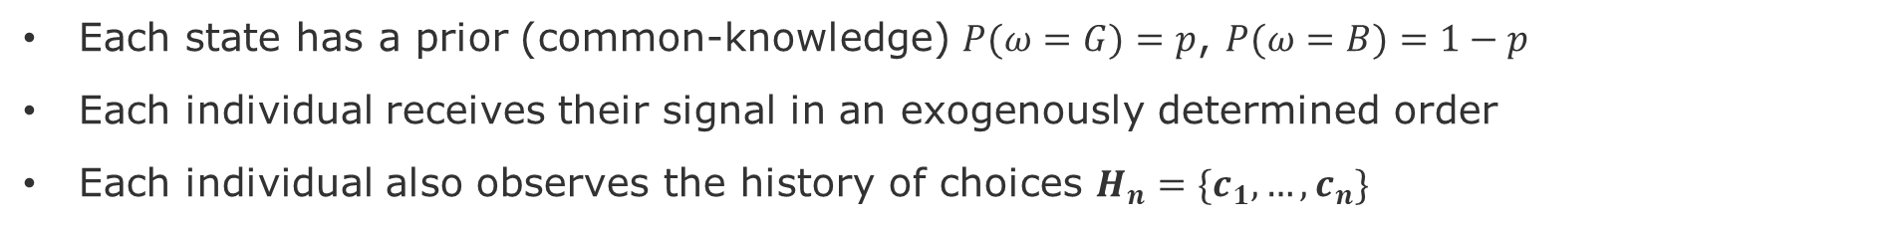
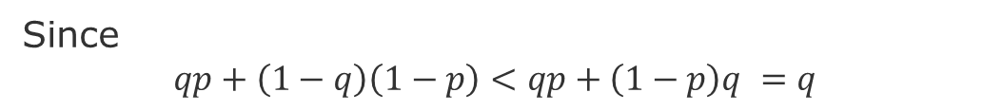
Individual decision
Each state has a prior (common-knowledge) $P(ω=G)=p$, $P(ω=B)=1−p$
Each individual receives their signal in an exogenously determined order
Each individual also observes the history of choices $H_{n}=\{c_{1},…,c_{n}\}$
$$P\left(ω=G\right| s_{i}=high)=\frac{P\left(high \right|G)P(G)}{P\left(high \right|G)P\left(G\right)+P\left(high \right|B)P(B)}$$
(Bayes Rule )
$$=\frac{qp}{qp+(1−q)(1−p)}$$
Since
$$qp+\left(1−q\right)\left(1−p\right)<qp+\left(1−p\right)q =q$$
Then
$qp+\left(1−q\right)\left(1−p\right)$<q
$$P\left(ω=G\right| s_{i}=high)>p$$
This makes sense as G is a good idea given a high signal.

Slide 9

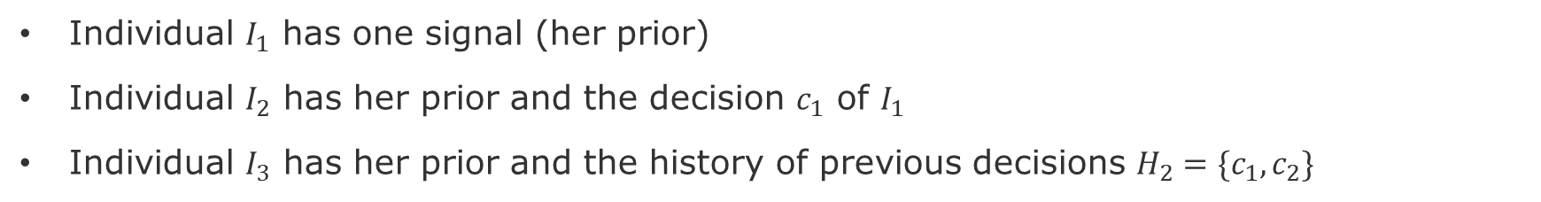
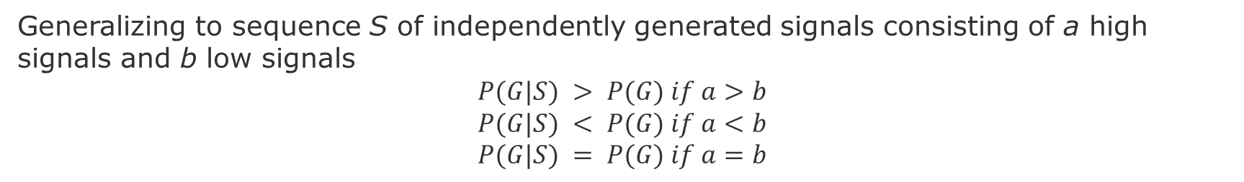

Multiple Signals – part1
Individual $I_{1}$ has one signal (her prior)
Individual $I_{2}$ has her prior and the decision $c_{1}$ of $I_{1}$
Individual $I_{3}$ has her prior and the history of previous decisions ${H_{2}=\{c}_{1},c_{2}\}$
Generalizing to sequence S of independently generated signals consisting of a high signals and b low signals
$$P(G|S) > P(G) if a>b$$
$$P(G|S) < P(G) if a<b$$
$$P(G|S) = P(G) if a=b$$
$$P(G|S) = \frac{P(G)P\left(S | G\right)}{P(S)}$$
Because signals are generated independently, we can simply multiply their probabilities
$$P\left(S | G\right)=q^{a}{\left(1−p\right)}^{b}$$
$$P\left(S\right)=P\left(G\right)P\left(S | G\right)+P\left(B\right)P\left(S | B\right)=pq^{a}{\left(1−q\right)}^{b}+\left(1−p\right){\left(1−q\right)}^{a}q^{b}$$
Putting numerator and denominator together
$$P(G|S) = \frac{{pq}^{a}{\left(1−q\right)}^{b}}{pq^{a}{\left(1−q\right)}^{b}+\left(1−p\right){\left(1−q\right)}^{a}q^{b}}$$
Is this posterior larger or smaller than p?

Slide 10
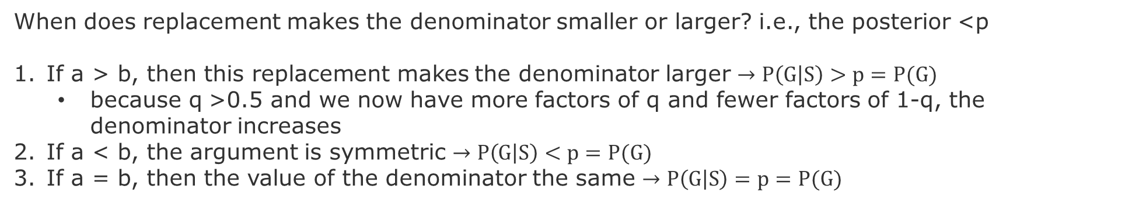


Multiple Signals – part2
Is the posterior $P(G|S)$ larger than the prior p?
$$P(G|S) = \frac{{pq}^{a}{\left(1−q\right)}^{b}}{pq^{a}{\left(1−q\right)}^{b}+\left(1−p\right){\left(1−q\right)}^{a}q^{b}}$$
If we were to replace the second term in the denominator by $\left(1−p\right){q^{a}\left(1−q\right)}^{b}$,
Then the denominator would become $pq^{a}{\left(1−q\right)}^{b}+\left(1−p\right){q^{a}\left(1−q\right)}^{b}=q^{a}{\left(1−q\right)}^{b}$,
The posterior would become:
$$P\left(G | S\right)= \frac{{pq}^{a}{\left(1−q\right)}^{b}}{q^{a}{\left(1−q\right)}^{b}}=p$$
When does replacement makes the denominator smaller or larger? i.e., the posterior <p
If a > b, then this replacement makes the denominator larger $→P\left(G | S\right)>p=P(G)$
because q >0.5 and we now have more factors of q and fewer factors of 1-q, the denominator increases
If a < b, the argument is symmetric $→P\left(G | S\right)<p=P(G)$
If a = b, then the value of the denominator the same $→P\left(G | S\right)=p=P(G)$

Slide 11
Cascades with activation time
User activation: when the users starts tweeting protest messages
k_{in} = total number of neighbors when a user became active
k_{a} = total number of active neighbors when a user became active
Activation threshold = k_{a}/ k_{in} , fraction of neighbors at the time when user becomes active
low social pressure
high social pressure
k_{a}/ k_{in}=0/4 = 0
k_{a}/ k_{in}=3/4 = 0.75
If k_{a}/ k_{in} → 0, user joins when very few neighbors are active
If k_{a}/ k_{in} → 1, user joins after most of neighbors are active
sources: Lecture 12 Network Effects and Cascading Behavior, Stanford CS224W, Jures Leskovec
Notes:
Cascading process is Non-reversible process. Nodes made a decision because they believed that individually they would get benefit to join the cascade.

Slide 12
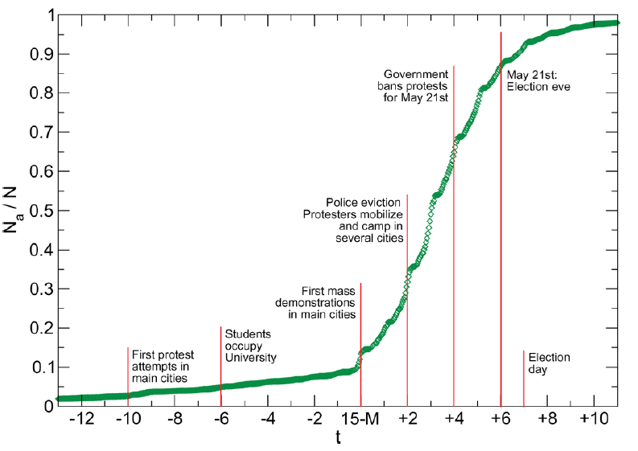
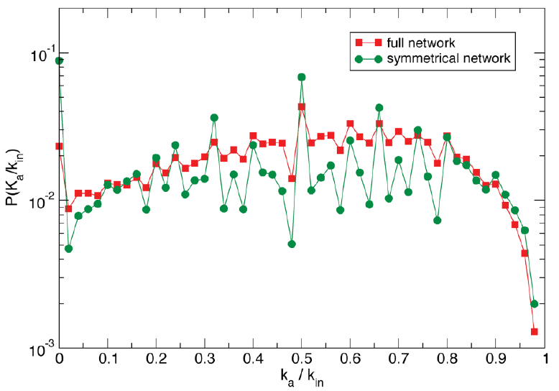
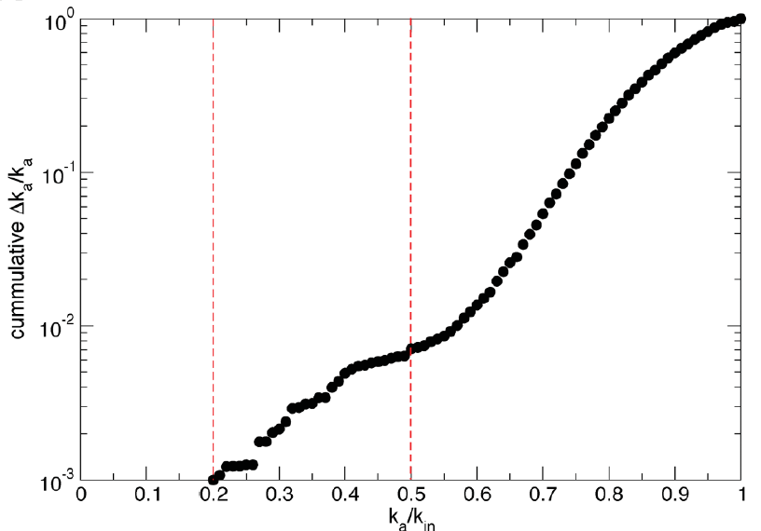
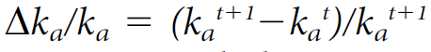
Activation threshold and Burstiness of Cascades
Zero activation threshold
0.5
Mostly uniform distribution, except for a few peaks
[Gonzalez-Bailó et al. 2011]
Burstiness
Δk_{a} /k_{a} =that some users might be susceptible to ‘‘recruitment bursts’’, that is, more likely to join if many of their neighbors do in a short time-span.
Insensitive to bursts
Highly sensitive to bursts
[Ratkiewicz et al. 2010]
Wang, S. et al., (2015), Burst Time Prediction in Cascades
Gonzalez-Bailo´, S., et al. , (2011), The Dynamics of Protest Recruitment through an Online Network
Ratkiewicz, J., et al., (2010) Characterizing and Modeling the Dynamics of Online Popularity
Notes:
Gonzalez-Bailo´ et al. , (2011), The Dynamics of Protest Recruitment through an Online Network

Slide 13
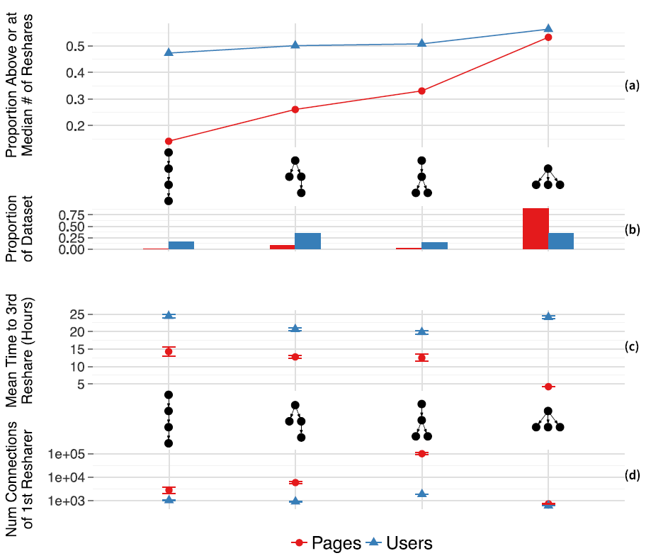
Cascades - Challenges
Note however that cascades
can be wrong
can be based on very little information
can be fragile
Most cascades are short
Long cascades are challenging to predict
Shallow initial cascade structures are indicative of larger cascades
[Cheng et al. 2014]
Surowiecki, J., (2005) The Wisdom of Crowds
Easley, D.,& Kleinberg, J., (2010) Networks, Crowds, and Markets: Reasoning about a Highly Connected World.
Cheng, J., Adamic, L., Dow, P. A., Kleinberg, J. M., & Leskovec, J. (2014). Can cascades be predicted?

Slide 14
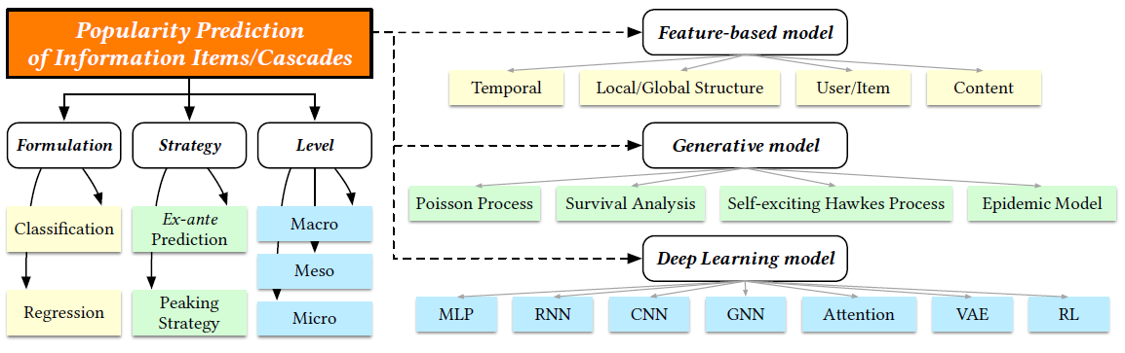
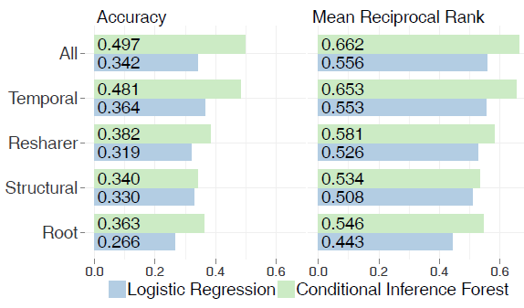
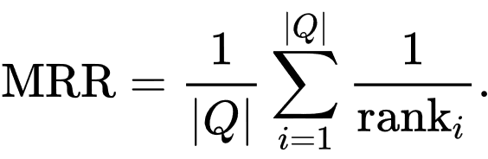
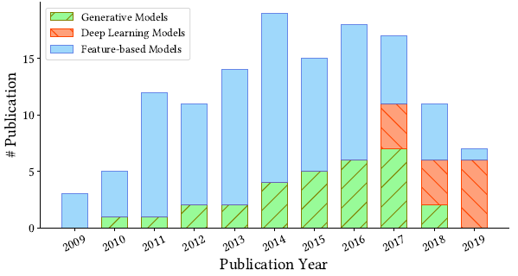
Prediction models for cascades
Rank position of first relevant element for the i^{th} query of samples queries Q.
This cascade also appears in the top two predicted cascades almost all the time.
Features
predicting the largest cascade in clusters of 10+ cascades of identical photos on Facebook
Zhao et al., (2020), A Survey of Information Cascade Analysis: Models, Predictions and Recent Advances
Cheng, J., Adamic, L., Dow, P. A., Kleinberg, J. M., & Leskovec, J. (2014). Can cascades be predicted?
Notes:
The mean reciprocal rank is a statistic measure for evaluating any process that produces a list of possible responses to a sample of queries, ordered by probability of correctness
Ex-ante prediction: before the event
Peaking strategy: at the event
Macro: collective behavior of cascades
Micro: individual status/actions of users/items
Micro: concerns the behaviors of communities/clusters

Slide 15
Decision-Based Cascading Models

Slide 16
How to start (or prevent) a cascade?
Discover the super spreader nodes
Degree centrality: incoming edges of a node
k-core method: the biggest connected subgraph where each node has at least degree k Repeatedly remove all nodes with degree less than K. The higher k-core, more central is the subgraph and corresponding nodes.
k-shell method:
Diversity (HIV study in South Africa)
2. Increase the incentives for event to spread (utility of products, trustworthiness of information, coupling between entities)
Notes:
The degree centrality (DC) [18] is the simplest index to measure nodes’ influence. The larger degree a node has, the

Slide 17
Propagation as Decision Making
Each person can adopt technology that maximizes its utility.
The benefit is based on how many of the neighbors adopted the same technology in t-1
For instance, if a node obtains a utility of “a” if the node adopts the technology A shared with a neighbor node.
Example: Technology adoption options are A, B, or AB. In the case of adopting AB, there is a cost “c”. Assuming that every node start with B, below is a possible intermediate state.
utility
-c
cost
-c
A
a
A
a
AB
max(a,b)
AB
b
B
How will the adoption of technology cascade through the network?
Will it cascade indefinitely, or will it stop at some point?
How do the individual costs of each pay-off affect the cascades?
source: Lecture 12 Network Effects and Cascading Behavior, Stanford CS224W, Jures Leskovec

Slide 18
Example
Path graph: start with B. and A is better than B, because a>b
What happens when one node switches to A?
With A, B, AB, Does A spread?
a=3
A
a=3
A
0
B
b=2
B
b=2
B
c=-1
-c
A
a=3
A
a=3
AB
b=2
AB
b=2
B
Hardwired to adopt A
source: Lecture 12 Network Effects and Cascading Behavior, Stanford CS224W, Jures Leskovec

Slide 19
Example with a=5, b=3, c=1
t1
a=5
A
A
0
B
B
B
a=5
b=3
b=3
c=-1
t2
a=5
A
a=5
A
a=5
AB
b=3
B
b=3
B
c=-1
t3
a=5
A
A
a=5
AB
AB
B
a=5
a=5
b=3
c=-1
t4
A
A
A
AB
AB
a=5
a=5
a=5
a=5
b=3
source: Lecture 12 Network Effects and Cascading Behavior, Stanford CS224W, Jures Leskovec

Slide 20
Generalized Decision Model
Given payoffs: Fp(A) = a, Fp(B) =1, Fp(AB) = a+1-c
When X will choose A, B, AB?
A
X
B
B vs A
a=1, c>1 → AB ϵ[-∞,1], B=1, A=1
a=1, c<1 → AB ϵ[1,2], B=1, A=1
AB vs B
a=c<1 → AB=1, B=1, A<1
a=c>1 → AB=1, B=1, A>1
Cost c
A
B
A
c=1
AB vs A
c=1, a<1 → AB=A<1, B=1, A<1
c=1, a>1 → AB=A>1, B=1, A>1
B
AB
AB
a=1
Payoff a
a=c=1 → AB=B=A=1
sources: Lecture 12 Network Effects and Cascading Behavior, Stanford CS224W, Jures Leskovec
Notes:
] Eisenberg, Joseph. "R0

Slide 21
Generalized Decision Model
Given payoffs: Fp(A) = a, Fp(B) =2, Fp(AB) = a+1-c
When X will choose A, B, AB?
AB
X
B
B vs A
a=2, c>1 → AB ϵ[-∞,2], B=2, A=2
a=2, c<1 → AB ϵ[2,3], B=2, A=2
AB vs B
c=a-1,c<1 → AB=2, B=2, A ϵ [1,2]
c=a-1,c>1 → AB=2, B=2, A > 2
Cost c
A
B
A
c=1
AB vs A
c=1, a<2 → AB=A<2, B=2, A<2
c=1, a>2 → AB=A>2, B=2, A>2
B
AB
AB
1
2
Payoff a
a=2,c=1 → AB=B=A=2
source: Lecture 12 Network Effects and Cascading Behavior, Stanford CS224W, Jures Leskovec
Notes:
Other readind
Bond, R. M., Fariss, C. J., Jones, J. J., Kramer, A. D., Marlow, C., Settle, J. E., & Fowler, J. H. (2012). A 61-million-person experiment in social influence and political mobilization. Nature, 489(7415), 295-298.
Bessi, A., & Ferrara, E. (2016). Social bots distort the 2016 US Presidential election online discussion. First Monday, 21(11-7).

Slide 22
Probabilistic Cascading Models

Slide 23
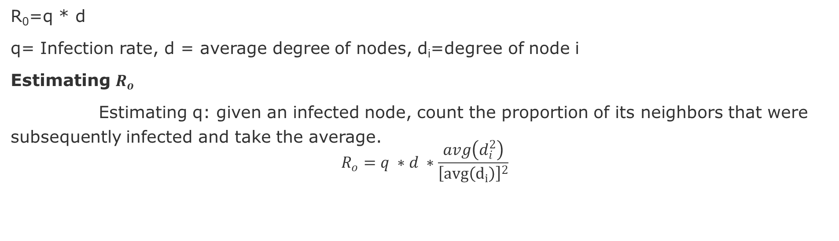
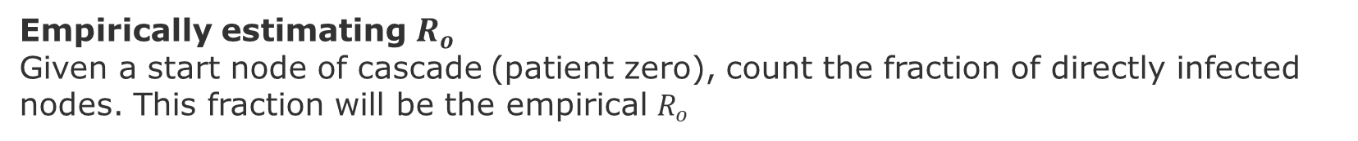
R₀ The R ZERO
R₀=q * d
q= Infection rate, d = average degree of nodes, d_{i}=degree of node i
Estimating $R_{o}$
Estimating q: given an infected node, count the proportion of its neighbors that were subsequently infected and take the average.
$$R_{o}=q ∗d ∗\frac{avg\left(d_{i}^{2}\right)}{{\left[avg\left(d_{i}\right)\right]}^{2}}$$
Correction factor to mitigate skewed degree distribution of the network
Empirically estimating $R_{o}$
Given a start node of cascade (patient zero), count the fraction of directly infected nodes. This fraction will be the empirical $R_{o}$
Notes:
Beginning already gives a good estimate of the Ro, but we also see where it does not work well, for the super popular,
Reproductive number is non-stationary, because as more people get infected it gets more difficult to find other infected ones.
So, it has a concave shape, fast growth, plateaus, then decays.

Slide 24
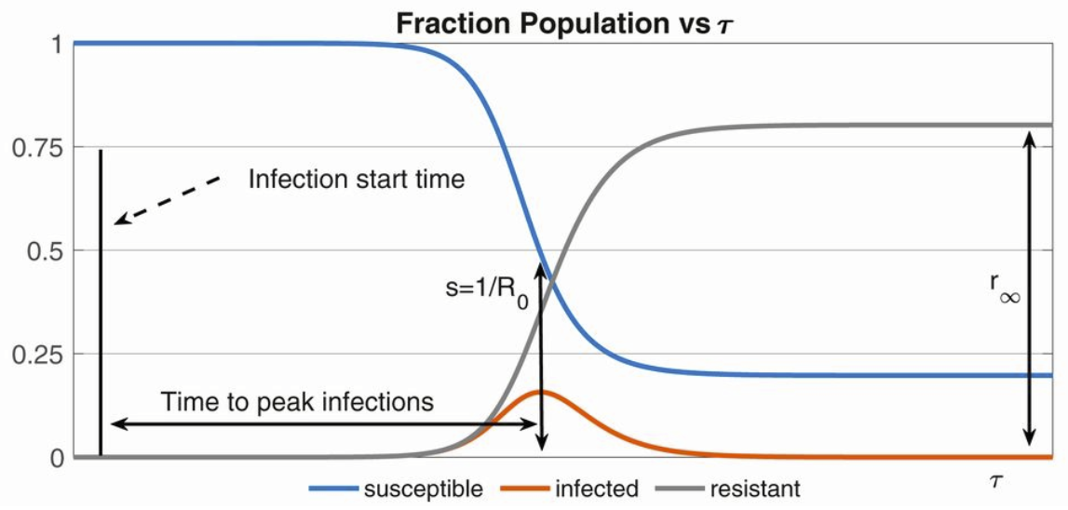
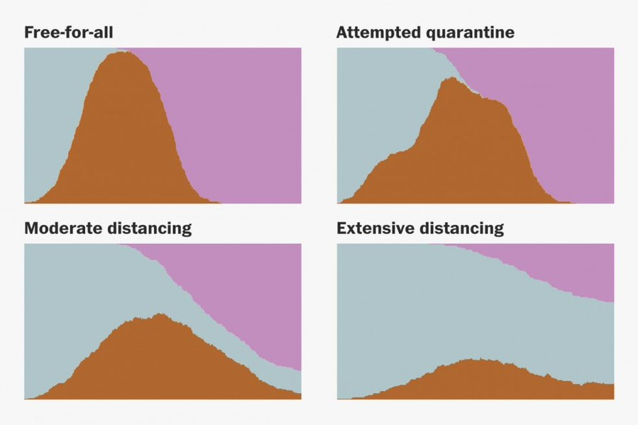
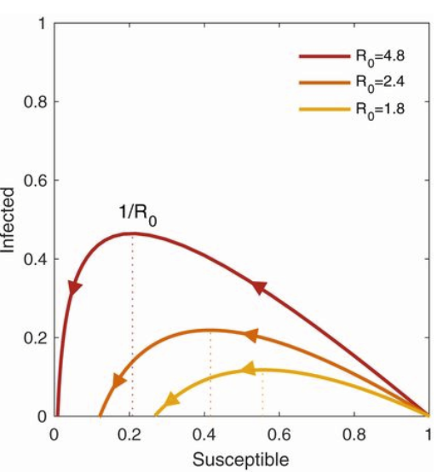
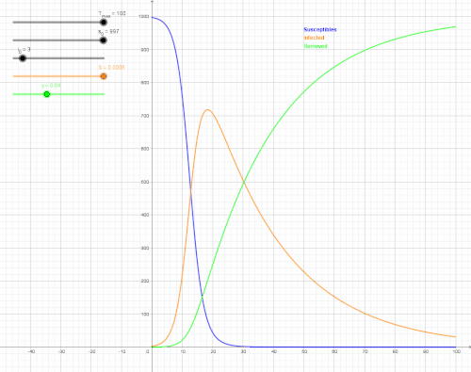
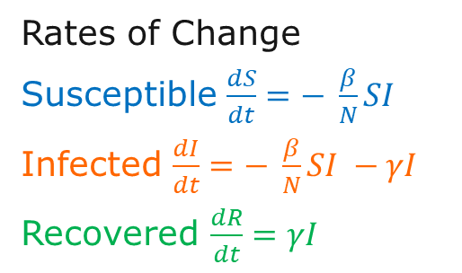
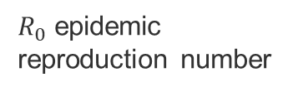
SIR model
α alpha
μ*
[Bertozzi 2020]
Susceptible
βI
Infected
γ
Recovered
μ
μ
μ
μ* birth rate
μ mortality rate
I infection rate
γ recovery rate
α reinfection rate
[Stevens 2020]: https://twitter.com/Harry_Stevens/status/1238940084994523136
S
I
R
$R_{0}$epidemic reproduction number
[Bertozzi 2020]
[Eisensberg 2020]
Rates of Change
Susceptible $\frac{dS}{dt}=− \frac{β}{N}SI$
Infected $\frac{dI}{dt}=− \frac{β}{N}SI −γI$
Recovered $\frac{dR}{dt}=γI$
[Wikipedia 2020]
Notes:
If alpha = zero, then we have lifelong immunity
[Wikipedia 2020] https://en.wikipedia.org/wiki/Compartmental_models_in_epidemiology#The_SIR_model
[Eisenberg 2020] Eisenberg, Joseph. "R0: How scientists quantify the intensity of an outbreak like coronavirus and its pandemic potential." The Conversation, Michigan University School of Public Health 27 (2020). https://sph.umich.edu/pursuit/2020posts/how-scientists-quantify-outbreaks.html
[Bertozzi 2020] Bertozzi, Andrea L., et al. "The challenges of modeling and forecasting the spread of COVID-19." Proceedings of the National Academy of Sciences 117.29 (2020): 16732-16738.
[Stevens 2020] Why outbreaks like coronavirus spread exponentially and how to "flatten the curve"
https://twitter.com/Harry_Stevens/status/1238940084994523136

Slide 25
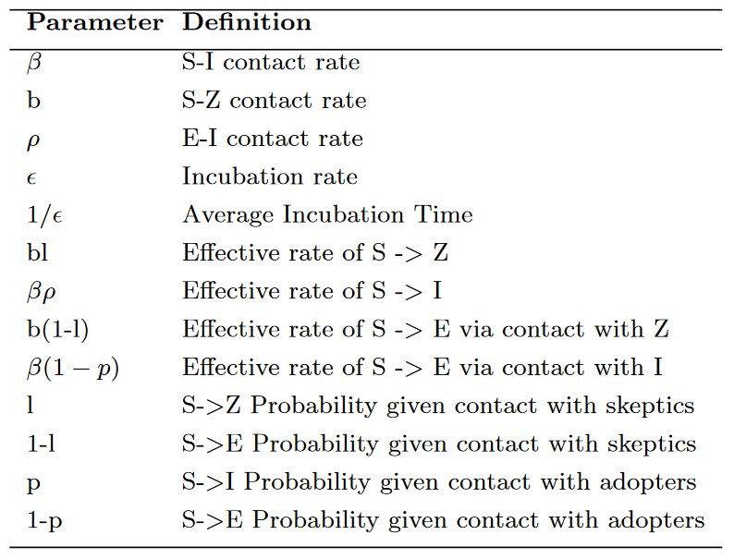
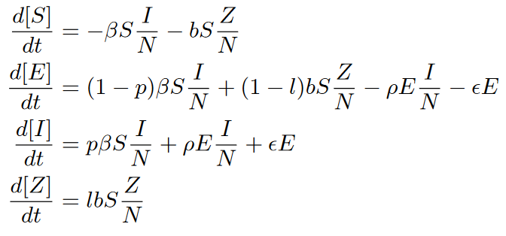
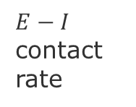
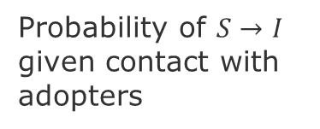
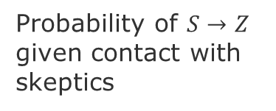
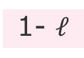
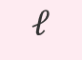
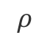
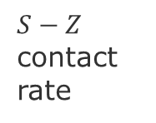
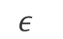
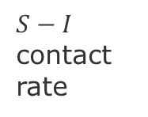
SEIZ model
S susceptible, E exposed, I infection rate, Z skeptics
Probability of $S→I$ given contact with adopters
α alpha
$S−I$ contact rate
Infected
p
$$ε$$
Susceptible
β
$$ρ$$
1-p
Exposed
$E−I$ contact rate
$S−Z$ contact rate
b
1- $ℓ$
Skeptic
N = population size
Probability of $S→Z$ given contact with skeptics
$$ℓ$$
Notes:
Jin, et al. 2013, Epidemiological Modeling of News and Rumors on Twitter
Vosoughi, S., Roy, D., & Aral, S. (2018). The spread of true and false news online. Science, 359(6380), 1146-1151.

Slide 26
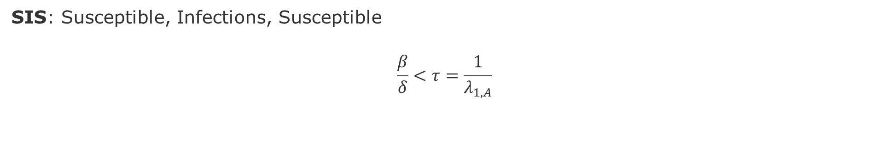
Other models
Epidemic threshold (we have not pandemic)
SIS: Susceptible, Infections, Susceptible
$$\frac{β}{δ}<τ=\frac{1}{λ_{1,A}}$$
Virus death rate
Virus birth rate
Largest eigenvalue of adjacency matrix A of the Graph. This alone captures the properties of the graph.
SEIHFR: S=Susceptible, E=Exposed individuals, I=Infections cases in the community, H=Hospitalized cases, F=dead but not yet buried, R=individual no longer transmitting
Susceptible
Exposed
Infectious
Hospitalized
Dead not buried
Recovered
See chapter 16 of Newman, M., (2016) Networks, second edition
Gomes, M. F., y Piontti, A. P., Rossi, L., Chao, D., Longini, I., Halloran, M. E., & Vespignani, A. (2014). Assessing the international spreading risk associated with the 2014 West African Ebola outbreak. PLoS currents, 6.

Slide 27
Failure Cascades in Power Grids
The topology of the network may not be the main factor in predicting failure cascades in power grids because these networks are affected by complex dynamical phenomena [Kinney-etal-2005][Newman 2016]
Metrics to measure network reliability/resilience to attacks [Pagani & Aiello 2013]:
Connectivity loss, Efficiency, Loss of load probability,
Influence on largest component size and path length,
Robustness through mean degree, motifs, and patch size analysis
Sensitivity
Flow availability
Line overload
Notes:
Pagani, G. A., & Aiello, M. (2013). The power grid as a complex network: a survey. Physica A: Statistical Mechanics and its Applications, 392(11), 2688-2700.
Kinney-etal-2005_Modeling cascading failures in the North American power grid
Newman, M. (2018). Networks. Oxford university press.

Slide 28
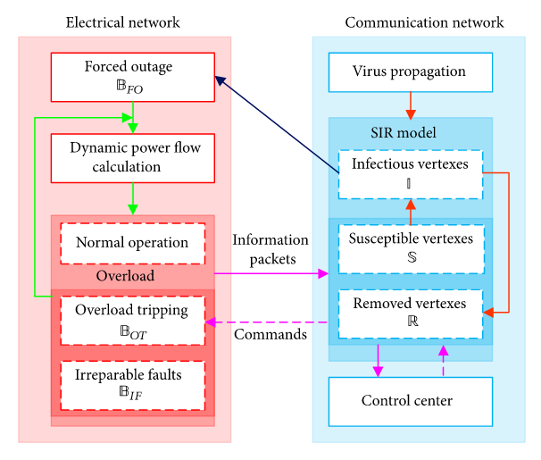
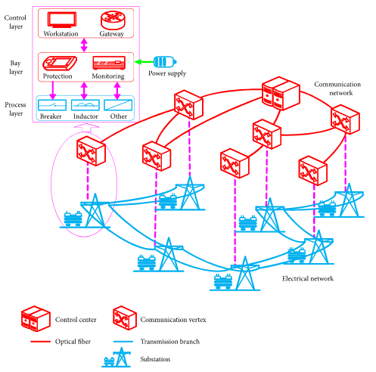
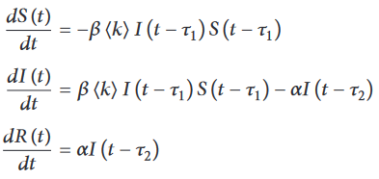
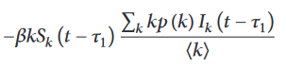
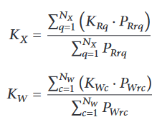
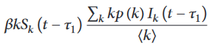
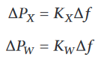
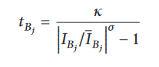


Cascade Failures in Electrical Communication Networks (ECN) [wang 2019]
interdependent fault propagation model
ECN= smart grid to monitor and control electrical networks
Virus infection propagates causing a failure cascades leading to energy blackouts.
SIR expressed in vertex degree
System frequency characteristics
Load Px and Generation Pw
Redistribute Power Unbalance
Dynamic Power Flow Algorithm
overloaded operational time at each branch Bj
source: Wang et al. (2019), Cascading Failures Analysis Considering Extreme Virus Propagation of Cyber-Physical Systems in Smart Grids
Notes:
Tau-1 infection cycle
Tau-2 removal cycle
Kx = Equivalent load frequency regulation
Kw = Equivalent generator unit power regulation
Delta Px = Changes in power of all loads
Delta Px = Changes in power of all generators
Delta Omega = Changes of angular acceleration of equivalent generator
Rotor equation allow to compute the
Delta Kxq = Changes of power of load q
Delta Kwc = Changes of power of generator c
Tj =Equivalent Inertia time constant
KE = system unit power regulation
Interactive Cascading Failure Model
Power flow redistribution employs
primary frequency regulation ‎[46, 47] and rotor equation ‎[48]
Two types of flow: communication and power
Two Time windows:
- virus infection cycle (SIR)
tripping time of overloaded branches
[Wang

Slide 29







Dynamic Power Flow Algorithm
source: Wang et al. (2019)
Notes:
Wang et al. (2019), Cascading Failures Analysis Considering Extreme Virus Propagation of Cyber-Physical Systems in Smart Grids

Slide 30
Outbreak Detection

Slide 31




The Phenomenon of Diminishing Returns
[Krause & Golovin 2014]
[Liu et al. 2020]
Adding s’ to
set A = {s1, s2}
B
Adding s’ to
set B = {s1, s2,s3,s4}
A
Diminishing returns means that adding the same sensor to superset of A would provide an equal or lower marginal gain than adding to set A.
i.e., “the more I know the less I gain from acquiring more items to the set”
The marginal gain can be:
Cost/loss (of picking a combination of items)
Probability (of contagion or protection)
Utility (of matching services and clients)
Krause, A. , Golovin, D., (2014), Submodular Function Maximization
Liu, Y., et al., (2020), Submodular optimization problems and greedy strategies: A survey. Discrete Event Dynamic Systems: 1-32.
Notes:
The problem of maximizing a monotone submodular function subject to a cardinality constraint admits a 1 − 1 / e approximation algorithm
Krause, A. , Golovin, D., 2014, Submodular Function Maximization.

Slide 32

Phenomena with Diminishing returns
Maximization problems
Information gathering, F(S) = Information
Sensor placing, Monitoring, Testing
Summarization, F(S) = Representation
Image recognition, Dictionary learning
Influence maximization, F(S) = Spread
Contagion, Behavior/Technology adoption
Coverage Function$F\left(S\right)=|U_{v∈S}area(v)|$
$v$ is a sensor or node, S set of sensors
V
V
Z
W
Z
X
W
Y
Y
S
S’
$$F\left(S U v\right)−F\left(S\right)≥F\left(S′ U v\right)−F\left(S′\right)$$
B
C
Diffusion in networks is a stochastic version of coverage
Minimization problems
Semi-supervised learning
Clustering, F(S) = separation
Labeling, F(S) = matching
Dimensionality reduction
Denoising, F(S) = coherence
A
F
C
E
These problems can be efficiently solved by a particular class of submodular functions called poly-matroids and greedy algorithms.
Notes:
Spread is a stochastic version of coverage submodular function.

Slide 33



Non-Decreasing - Monotone
If $A⊆ B →F\left(A\right)≤F\left(B\right)$
$\sum_{i∈C}{argmax_{j∈A}(u_{ij}) }≤$ $\sum_{i∈C}{argmax_{j∈B}(u_{ij}) }$
Because:
there is more to choose in B than in A
each new choice does not affect the utility of previous choices.
note, however, that every new choice, changes the utility of future choices.
B
A
$u_{i,j∈A∩B}$== $u_{i,j∉B}$
$$u_{i,j∉A}$$

Slide 34




Sensing problem - Entropy
Y₁
Y₄
Proof that entropy is submodular
$F(S) = H(X_{s})$ is the joint entropy of variables indexed by $S,$ asssuming that $A ⊂B$
$H\left(X_{A∪e}\right)– H\left(X_{A}\right)= H(X_{e}|X_{A})$
$≤H\left(X_{e} | X_{B}\right)$
$=H\left(X_{B∪e}\right) – H(X_{B})$
Discrete entropy is submodular
Y₂
Y₃
X₄
X₁
X₂
X₃
information never hurts
Goal: How to reduce the uncertainty about hidden variables Y_{i} given the observed ones X_{i}
What is a good objective function ?
$$F(A) = H(Y) – H(Y|X_{A}) = I(Y;X_{A})$$
Submodularity and Independence
$$X_{i}∈S statistically independent ↔H is modular \left(linear\right)on S$$
$$H\left(X_{S}\right)=\sum_{e∈S}{H(X_{e})}$$
Hence, if F is more submodular then the items in the S set are more dependent
Utility of having sensors in location A
Uncertainty about temperature Y before sensor reading
Uncertainty about temperature Y after sensor reading
Mutual Information between hidden and observed variables
F(A) is a submodular function if the X’s are conditionally independent given the Y’s, i.e., $X_{i} ⊥Xj≠j | Y$
Liu et al.(2020) Submodular optimization problems and greedy strategies
Jegelka, S., (2017), Submodularity: Theory and Applications I - https://www.youtube.com/watch?v=Y3u_hvxayDY
Notes:
Knowing more only shrinks entropy
F(A) is a submodular function if the Xs are conditionally independent given the Ys
Sub-additive when variables are independent, then we have the strict modularity with the equality
What is a good ob. Func.
Select x to learn about y?
How much I reduce my uncertain as I select Xs?

Slide 35

Why is submodularity important?
Allows to approximate to NP-hard problems of finding optimal subset of items that maximize or minimize an objective function, e.g., coverage, influence, etc.
This is possible via a greedy algorithm, i.e., greedily selecting items in A.
$F\left(A_{greedy}\right)≥\left(1−\frac{1}{e}\right)\max_{\left|A\right|≤k} F\left(A\right)$, i.e., approximation a lower bound of ~63% of the optimum $F\left(A\right)$ [Nemhauser et al. 1978]
Submodular functions occur in several real-world phenomena
Nemhauser, G. L., Wolsey, L. A., & Fisher, M. L. (1978). An analysis of approximations for maximizing submodular set functions—I. Mathematical programming, 14(1), 265-294.

Slide 36
Applications of submodular function optimization
Viral marketing [Kempe et al., 2003]
Network monitoring [Leskovec et al., 2007, Rodriguez et al., 2010]
Sensor placement and information gathering [Guestrin et al., 2005]
News article recommendation [El-Arini et al., 2009]
Non-parametric learning [Reed and Ghahramani, 2013]
Document and corpus summarization [Lin and Bilmes,2011, Kirchhoff and Bilmes, 2014, Sipos et al., 2012]
Data summarization [Mirzasoleimanet al., 2013]
Crowd teaching [Singla et al., 2014]
MAP inference of “determinantal” point-process [Gillenwater et al., 2012]
In many of these problems can be reduced to a problem of maximizing a submodular function that is subject to constraints like cardinality, knapsack, and intersection of matroids.
Feldman et al. (2017) Greed Is Good: Near-Optimal Submodular Maximization via Greedy Optimization
Notes:
From Feldman et al. (2017), Greed Is Good: Near-Optimal Submodular Maximization via Greedy Optimization
[Kempe et al., 2003] David Kempe, Jon Kleinberg, and ́Eva Tardos. Maximizing the spread of influence through asocial network. In KDD, 2003
[Leskovec et al., 2007] Jure Leskovec, Andreas Krause, Carlos Guestrin, Christos Faloutsos, Jeanne Van Briesen, andNatalie Glance. Cost-effective outbreak detection in networks. In KDD, 2007
[Rodriguez et al., 2010] Manuel Gomez Rodriguez, Jure Leskovec, and Andreas Krause. Inferring networks of diffusion and influence. In KDD, 2010
[Guestrin et al., 2005] Carlos Guestrin, Andreas Krause, and Ajit Paul Singh. Near-optimal sensor placements in gaussian processes. In ICML, 2005
[El-Arini et al., 2009] Khalid El-Arini, Gaurav Veda, Dafna Shahaf, and Carlos Guestrin. Turning down the noise in the blogosphere. In KDD, 2009
[Reed and Ghahramani, 2013] Colorado Reed and Zoubin Ghahramani. Scaling the indian buffet process via submodular maximization. In ICML, 2013
[Lin and Bilmes,2011] Hui Lin and Jeff Bilmes. A class of submodular functions for document summarization. In ACL, 2011
[Kirchhoff and Bilmes, 2014] Katrin Kirchhoff and Jeff Bilmes. Submodularity for data selection in statistical machine translation. In EMNLP, 2014
[Sipos et al., 2012] Ruben Sipos, Adith Swaminathan, Pannaga Shivaswamy, and Thorsten Joachims. Temporal corpus summarization using submodular word coverage. In CIKM, 2012
[Mirzasoleimanet al., 2013] Baharan Mirzasoleiman, Amin Karbasi, Rik Sarkar, and Andreas Krause. Distributed submodular maximization: Identifying representative elements in massive data. In NIPS, 2013.
[Singla et al., 2014] Adish Singla, Ilija Bogunovic, G ́abor Bart ́ok, Amin Karbasi, and Andreas Krause. Near-optimally teaching the crowd to classify. In ICML, 2014
[Gillenwater et al., 2012] Jennifer Gillenwater, Alex Kulesza, and Ben Taskar. Near-optimal MAP inference for determinantal point processes. In NIPS, 2012

Slide 37


Example of Combinatorial Optimization Problems
B
5
Graph cut problems
Graph cut defines two disjoint subsets of nodes and the weight of the cut is defined to be equal to the sum of the weights of edges that connect the disjoint subsets.
Min Cut minimum if the weight of the cut is not larger than the size of any other cut. Polynomial.
Max Cut maximum if the weight of the cut is not smaller than the size of any other cut. NP-Complete
Sparsest cut bipartition the vertices that minimize the ratio of the number of edges across the cut divided by the number of vertices in the smaller half of the partition NP-hard
Wikipedia
C
5
15
A
5
5
F
C
5
10
E
5
Computational Complexity
P: $X ∈P$ if it has an algorithm whose complexity is a polynomial function of its inputs
NP: (Non-deterministic polynomial) $X ∈NP$ if there’s a polynomial-time algorithm to check a solution, but not to find one.
NP-Complete: $X ∈NP Complete$ if it is possible to reduce X to another NP problem $Y$ in polynomial-time.
NP-Hard: – $X ∈NP Hard$ if there’s an NP-complete problem $Y$ that is reducible to $X$ in polynomial time
[Cormen et al. 2015]
Matching problems
Maximal matching, Perfect matching
String matching find where several strings are found within a larger string or text.
Graph traversal problems
Minimum Spanning Tree
Traveling Salesman
B
5
C
B
C
5
15
A
5
5
F
A
F
10
C
E
5
C
E
5
Notes:
Examples of discrete optimization problems are spanning trees, matchings, graph cuts, traveling salesman, knapsack, minimum clique, vertex cover, set Cover.
Some problems are in P:
Min Spanning Tree, Max Flow, Min Cut, Max Matching,...
Many problems are NP-hard:
Traveling Salesman, Max Clique, Max Cut, Set Cover, Knapsack
Graph cut algorithms:
Minimum Cut –Edmonds-Karp Algorithm [1]
Maximum Cut – It an be approximated to within a constant ratio using semidefinite programming [2]
Sparsest Cut – It can be approximated using Arora, Rao & Vazirani [3] with a complexity O((log n)^1/2) [3]
[1] Cormen, Thomas H.; Leiserson, Charles E.; Rivest, Ronald L.; Stein, Clifford (2001), Introduction to Algorithms (2nd ed.), MIT Press and McGraw-Hill, p. 563,655,1043, ISBN 0-262-03293-7.
[2] Goemans, M. X.; Williamson, D. P. (1995), "Improved approximation algorithms for maximum cut and satisfiability problems using semidefinite programming", Journal of the ACM, 42 (6): 1115–1145, doi:10.1145/227683.227684.
[3] Arora, Sanjeev; Rao, Satish; Vazirani, Umesh (2009), "Expander flows, geometric embeddings and graph partitioning", J. ACM, ACM, 56 (2): 1–37, doi:10.1145/1502793.1502794.
Computational Complexity
P – Complexity is a Polynomial function of the inputs
NP – (Non-deterministic polynomial) X is NP if has polynomial-time solution checking, but non-Polynomial time solution finding
NP-Complete – X is NP-Complete if it is possible to reduce X to another NP problem Y in polynomial time.
NP-Hard – X is NP-Hard if there is an NP-complete problem Y that is reducible to X in polynomial time
Nice summary here:
https://stackoverflow.com/questions/1857244/what-are-the-differences-between-np-np-complete-and-np-hard

Slide 38

Short historical perspective of submodular functions
(70’s-90’s) Foundations of combinatorial optimization:[Edmonds, Lovász, Schrijver, Welsh,...]
Topics: rank functions of matroids, polymatroids, matroid intersection, submodular flows and minimization
Algorithms: submodular functions often appear in the background of P-time solvable problems.
(2000-now) Algorithmic game theory:[Lehmann, Nisan, Dobzinski, Papadimitriou, Kempe, Kleinberg, Tardos,...]
Topics: submodular functions to model valuation functions of agents with diminishing returns
Algorithms: algorithms and incentive-compatible mechanisms for problems like combinatorial auctions, cost sharing, and marketing on social networks.
(2005-now) Machine learning:[Guestrin, Krause, Gupta, Golovin, Bilmes,...]
Topics: submodular functions often appear as objective functions of machine learning tasks such as sensor placement, document summarization or active learning
Algorithms: Greedy, Local Search, Sketch
Vondrak, J., (2012), Submodular Functions and Their Applications, Discrete Math Conference, https://theory.stanford.edu/~jvondrak/data/SIDMA-plenary-talk.pdf
Liu, Y., et al., 2020, Submodular optimization problems and greedy strategies: A survey. Discrete Event Dynamic Systems: 1-32.
Notes:
More updates here https://youtu.be/Y3u_hvxayDY?t=1737
Viral marketing [Kempe et al., 2003]
Network monitoring [Leskovec et al., 2007, Gomez Rodriguez et al., 2010]
Sensor placement and information gath-ering [Guestrin et al., 2005]
News article recommendation [El-Arini et al., 2009]
Nonparametriclearning [Reed and Ghahramani, 2013]
Document and corpus summarization [Lin and Bilmes,2011, Kirchhoff and Bilmes, 2014, Sipos et al., 2012]
Data summarization [Mirzasoleimanet al., 2013]
Crowd teaching [Singla et al., 2014]
MAP inference of “determinantal” point-process [Gillenwater et al., 2012]

Slide 39







Submodularity as Information of a set [Bilmes 2020]
A function $F: 2V→R$is submodular if for any $A,B ⊆ V,$we have that
$F\left(A\right)+ F\left(B\right)≥F\left(A∪B\right)+F\left(A∩B\right)$ (definition 2)
Sets $A,B ⊆ V$ , where $v∈V$ is an index
Let $C ⊆ V$ represent the common index that lies within sets $A$ and $B$, i.e., $A∩B≥C$
hence, the common index is upper-bounded by common value $A∩B$
Then $F\left(A∩B\right) ≤F\left(C\right)$
A
B
C
$$F\left(A\right)+ F\left(B\right) ≥ F\left(A∪B\right) + F\left(A∩B\right)$$
$$F\left(A_{r}\right)+2F\left(C\right)+ F\left(B_{r}\right)$$
$$F\left(A_{r}\right)+F\left(C\right)+ F\left(B_{r}\right)$$
$$F\left(A∩B\right)$$
A
B
A
B
C
$$2F\left(C\right)≥F\left(C\right)+F\left(A∩B\right)$$
$$F\left(C\right)≥F\left(A∩B\right)$$
source: [Bilmes 2020] J. Bilmes, EE563 - Submodular Functions, Optimization, and Applications to Machine Learning, Fall Quarter, 2020, https://people.ece.uw.edu/bilmes/classes/ee563/ee563_fall_2020/
Notes:
J. Bilmes, EE563 - Submodular Functions, Optimization, and Applications to Machine Learning, Fall Quarter, 2020
https://people.ece.uw.edu/bilmes/classes/ee563/ee563_fall_2020/

Slide 40



Submodularity as Information of a set [Bilmes 2020]
What happens when we have disjoint classes? i.e., $F\left(A∩B\right)=∅$
A
B
$$F\left(A\right)+ F\left(B\right) ≥ F\left(A∪B\right) + F\left(A∩B\right)$$
$$F\left(A_{r}\right)+ F\left(B_{r}\right)$$
$$F\left(A_{r}\right)+ F\left(B_{r}\right)$$
$$∅$$
A
B
A
B
$$F\left(A\right)+ F\left(B\right) = F\left(A∪B\right) + F\left(A∩B\right)$$

Slide 41

Example: Optimal Assignment Problem
We would like to know if the function that optimally assigns an item $c_{i}$ from a category $C$ to an item $s_{j}$ in a category $S$ in a way that maximizes the utility $u_{ij}$ for the item $c_{i}$.
Other instances of this class of problem are matching a client with a service, choosing a treatment to a patient, or recommending a movie to a user. In all cases one wants to maximize the total utility of assignments.
The formulation is as follows:
$F\left(S\right)=\sum_{i∈C}{argmax_{j∈S}(u_{ij})}$ ,
where $S_ij$ consists of a hypothetical assignment that has utility value.
Is this function submodular?
Notes:
This assignment is an injective function, because $c_{i}$can be assigned only once, but each multiple $c_{i}$ can be assigned to the same item $s_{j}$, whereas the reverse is not true.

Slide 42





Proof of Submodularity
$F\left(A\right)+F\left(B\right)=\sum_{i∈C}{argmax_{j∈A}(u_{ij})}$ + $\sum_{i∈C}{argmax_{j∈B}(u_{ij})}$
$F\left(A∪B\right) + F\left(A∩B\right)$ = $\sum_{i∈C}{argmax_{j∈A∪B}(u_{ij})}$ + $\sum_{i∈C}{argmax_{j∈A∩B}(u_{ij})}$
Intuition of the proof: look the possible combinations of choices of services contained in A, B, or both.
A
B
Expressing this in equations, we get:
$F\left(A\right)=\sum_{i∈C}{argmax_{j∈A}\left(u_{ij}\right)=max⁡(u_{i,j∉B},}u_{i,j∈A∩B})$
$F\left(B\right)=$ $\sum_{i∈C}{argmax_{j∈B}(u_{ij})}=u_{i,j∉A}$
$F\left(A∪B\right)=\sum_{i∈C}{argmax_{j∈A∪B}(u_{ij})}=max(u_{i,j∉A}$, $u_{i,j∉B,}u_{i,j∈A∩B})$
$F\left(A∩B\right)=\sum_{i∈C}{argmax_{j∈A∩B}(u_{ij})}=u_{i,j∈A∩B}$
$$u_{i,j∉B}$$
service in A, that is not in B
$$u_{i,j∉A}$$
service in B, that is not in A
$$u_{i,j∈A∩B}$$
service in A, that is also in B

Slide 43












Four cases - Proof of Submodularity
A
B
Case-1: the service in the intersection has lower utility, i.e., ${u_{i,j∈A∩B}<min⁡( u}_{i,j∉A}$ $u_{i,j∉B})$, then
$F\left(A\right)+F\left(B\right)=u_{i,j∉A}+u_{i,j∉B}= 2+2$
$F\left(A∪B\right) + F\left(A∩B\right)=max\left(u_{i,j∉A}\text{, }u_{i,j∉B},u_{i,j∈A∩B}\right)+$ ${min⁡( u}_{i,j∉A}$ $u_{i,j∉B})=2+1$
which implies the inequality $F\left(A\right)+ F\left(B\right)> F\left(A∪B\right) + F\left(A∩B\right)$
$u_{i,j∉B}$=2
$u_{i,j∈A∩B}$=1
$$u_{i,j∉A}=2$$
A
B
Cases-2 and 3: the service in the intersection has higher utility for $B$, hence it dominates other items in not A, i.e., ${u_{i,j∉A}<u_{i,j∈A∩B}< u}_{i,j∉B}$, then
$F\left(A\right)+F\left(B\right)=u_{i,j∉B}+u_{i,j∈A∩B}=3+2$
$F\left(A∪B\right) + F\left(A∩B\right)=max(u_{i,j∉A}\text{, }u_{i,j∉B},u_{i,j∈A∩B})+$ $u_{i,j∈A∩B}=3+2$
which implies the equality $F\left(A\right)+ F\left(B\right) = F\left(A∪B\right) + F\left(A∩B\right)$
$u_{i,j∉B}$=3
$u_{i,j∈A∩B}$=2
$$u_{i,j∉A}=1$$
A
B
Case-3: the services in the intersection has the highest utility, i.e., ${u_{i,j∈A∩B}>max⁡(u}_{i,j∉B}$, $u_{i,j∉A})$ then
$F\left(A\right)+F\left(B\right)=u_{i,j∈A∩B}+u_{i,j∈A∩B}= 2+2$
$F\left(A∪B\right) + F\left(A∩B\right)=u_{i,j∈A∩B}+$ $u_{i,j∈A∩B} =2+2$
which implies the equality $F\left(A\right)+ F\left(B\right) = F\left(A∪B\right) + F\left(A∩B\right)$
$u_{i,j∉B}$=1
$u_{i,j∈A∩B}$=2
$$u_{i,j∉A}=1$$
Notes:
In case-2: the service in the intersection is chosen for B. It however has to have lower value than the one chosen for the not B.

Slide 44
How to control these complex non-linear systems?
Continuous intervention via Feedback-Control
Model-Based Controller
disturbances
noise
set point
Slow Feedback Control
measurements
+
System
-
+
actuation
(intervention)
feedback signal
Course on Machine Learning for Controlling Dynamical Systems – Next semester

Slide 45
Final Presentations of GNN projects
05/Mar: Name Entity Disambiguation - Valdimar & Mai
17/Mar: Comment Predictions on Online News – Sassan
19/Mar: Protein Interactions – Henrik & Simon
24/Mar: Space-Time Graphs for Traffic Predictions – Max, Tiago & Tibor
26/Mar: Community Interaction Predictions – Bastian, Berkey & Leo
29/Mar: Key-phrase Classification - Maria
Last day to turn in the report March 29.

Slide 46
END

